Slide 1

English for Telephoning
Class: 18C1-NNA1
Time: 14.10 – 15.40pm. on Friday
Lecturer: Ms. Nguyen Thi Thanh Tu
Faculty of Foreign Languages
Ly Tu Trong College of Ho Chi Minh City

Slide 2
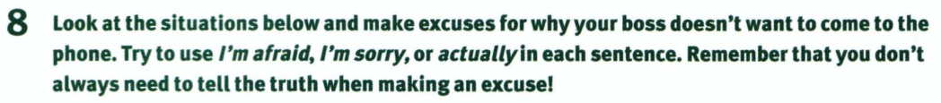
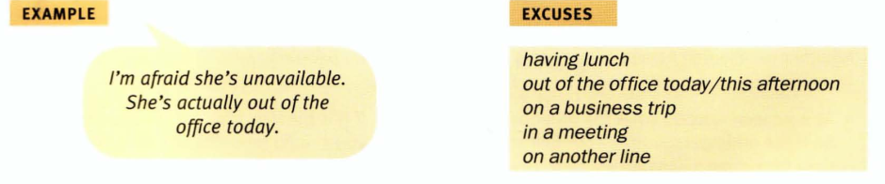
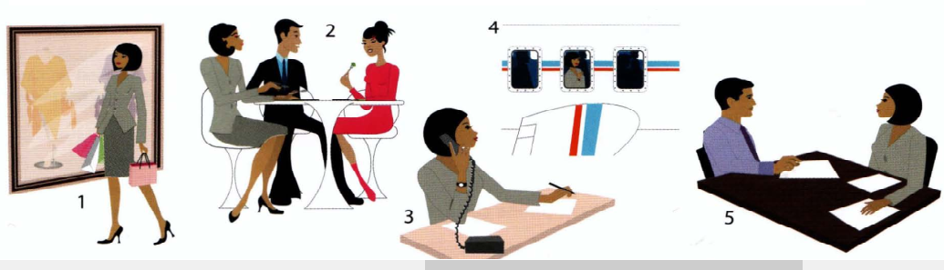
Unit 1: Shall I put you through? (cont.)

Slide 3
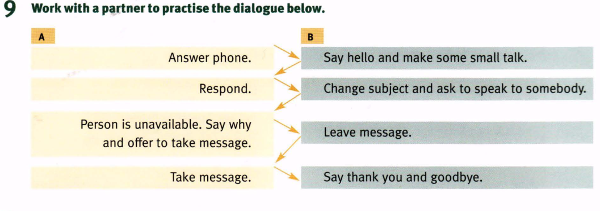
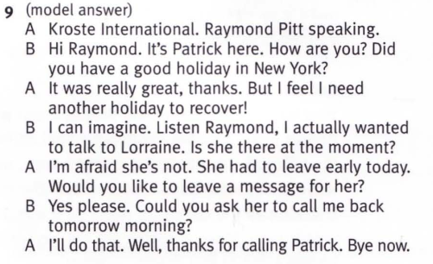

Slide 4
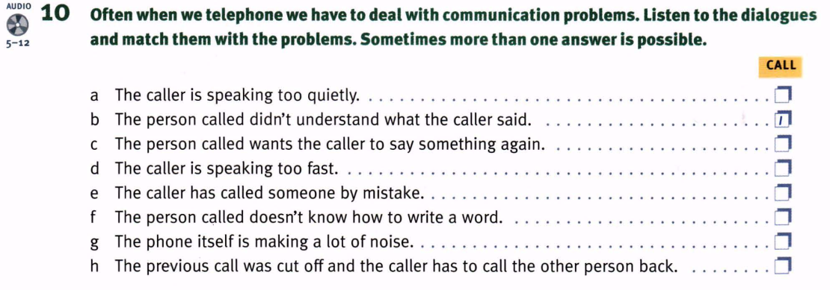

Slide 5
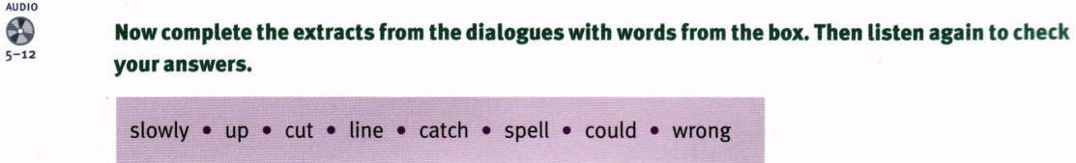
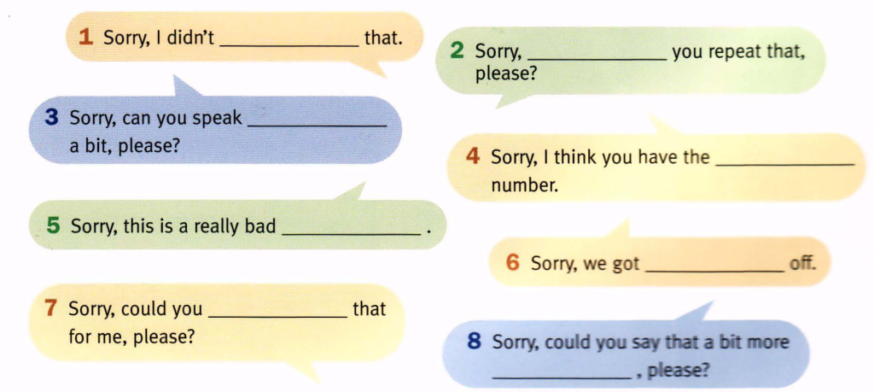

Slide 6
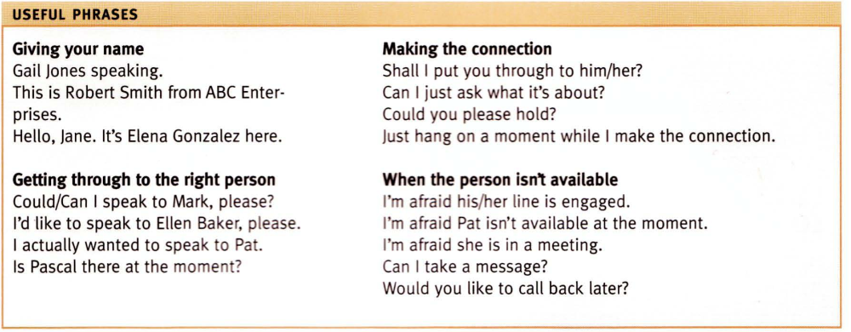

Slide 7
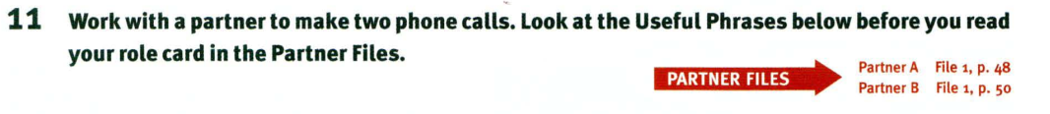
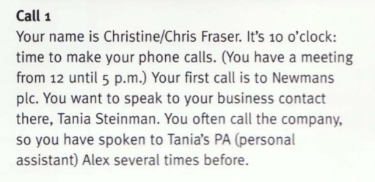
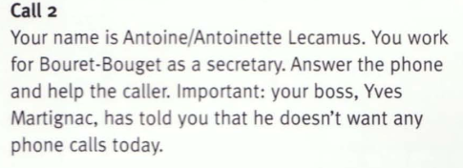
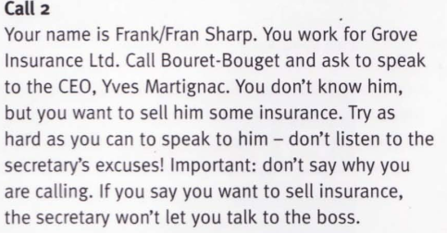
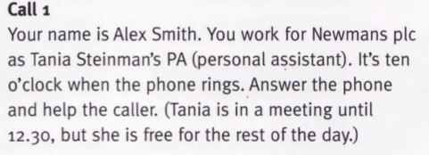
Partner A
Partner A
Partner B
Partner B

Slide 8
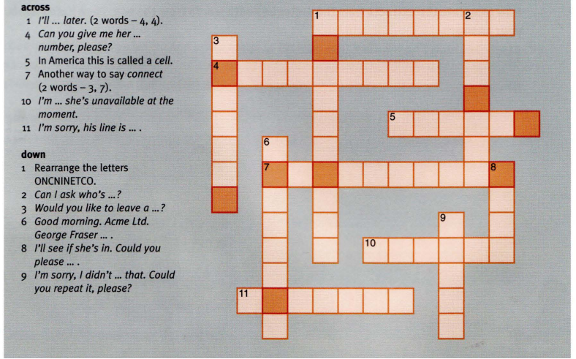

Slide 9
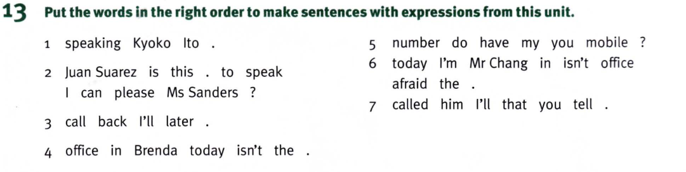

Slide 10

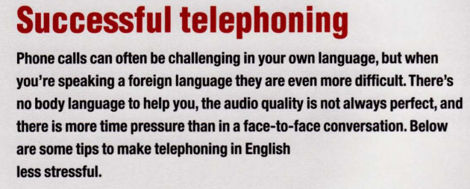

Slide 11
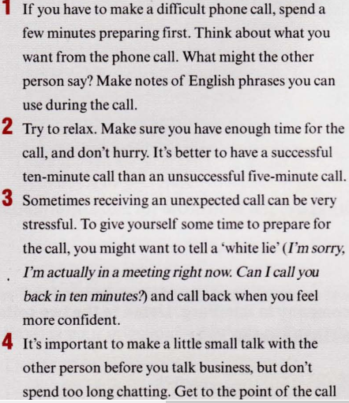
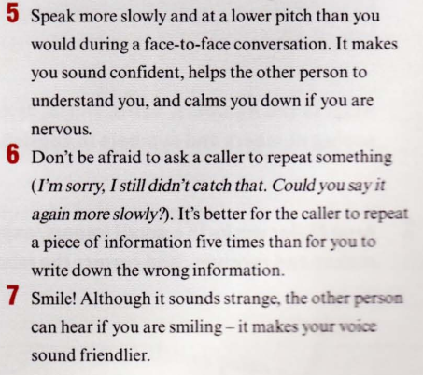
OVER TO YOU:
What is the thing you find most difficult on the phone? How could you make easier?
Can you think of five things you could do to improve your telephoning skills in English? For example, record English calls and listen to them with your English teacher, or telephone an English-speaking friend for practice.
quickly. If you’re talking to a native English speaker, listen for words like well, so, and anyway – these are signals that it’s time to talk business

Slide 12
Homework:
After these two periods you have to remember Useful Phrases;
do the crosswords in part 12, and read the article and discuss some questions in OUTPUT.
Prepare for unit 2: Could you spell that for me?

